Slide 1


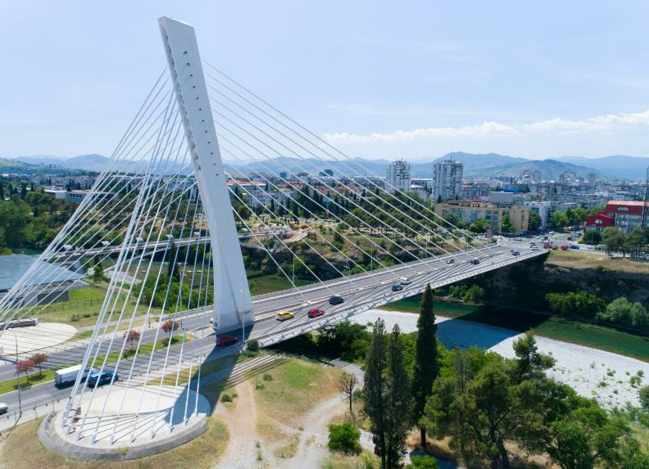
Western Balkan Strategic Partnership for Health Protection
(WASP)
Final In-Person Meeting
Podgorica, Montenegro
September 30 – October 1, 2025
Summary of Achievements

Slide 2








WASP Partners and Work Packages
Work Package 2
Clinical management and antimicrobial resistance (AMR) prevention and control
Work Package 1
Epidemiological crisis management and response
Work Package 3
Strengthening molecular diagnostics and sequencing capacities
Work Package 4
Improved surveillance of dynamic outbreaks within and across countries
Contact Persons
Ariane Halm
Janina Stauke
Contact Persons
Arina Zanuzdana (RKI)
Martina Gaßner (Charité)
Contact Persons
Sabrina Weiss
Andelé Conradie
Contact Persons
Aline Anton
Alexander Rommel
Partners
IPH Albania
NIPH Kosovo
IPH North Macedonia
IPH Montenegro
Partners
IPH Montenegro
NIPH Kosovo
KCCG Podgorica
Partners
IPH Montenegro
NIPH Kosovo
Partners
IPH Montenegro
IPH Albania
NIPH Kosovo
IPH North Macedonia
CIPH Serbia
University of Belgrade
NIPH Federation of Bosnia and Herzegovina
PHI Republic Srpska
Project Lead: Sabrina Weiss
Scientific Coordination: Kristina Aleksic-Babic
Administrative Support: Ludivine Thiel and Birgit Arnold

Slide 3


Clinical Center of Montenegro

Slide 4




Achievements of WP2 (Clinical Management) in Montenegro
          Webinars
          Content covers the Competency-Based Training in Intensive Care Medicine in Europe (CoBaTrICE)
          1st year: fundamentals in intensive care medicine with focus on antimicrobial stewardship, ventilation, hemodynamic, delirium
          2nd year: special topics like coagulopathy, intoxication, trauma management, brain injury, acute lung distress syndrome, case presentations
          3rd year: deepen knowledge in advanced intensive care medicine like neuroimaging, renal replacement therapy, extracorporal membrane oxygenation

Slide 5
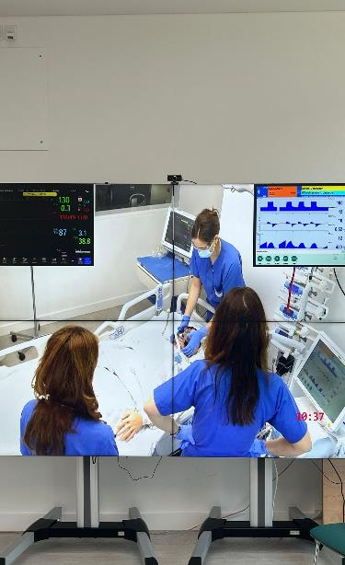
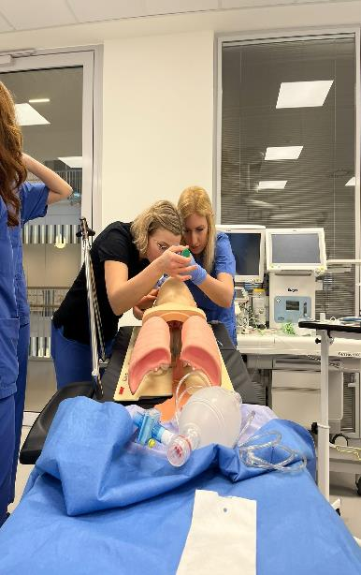
Achievements of WP2 (Clinical Management) in Montenegro
          Simulation Centre:
            Intubation
            Resuscitation
            Emergency airway management
            Scoring in ICU
            Team training

Slide 6
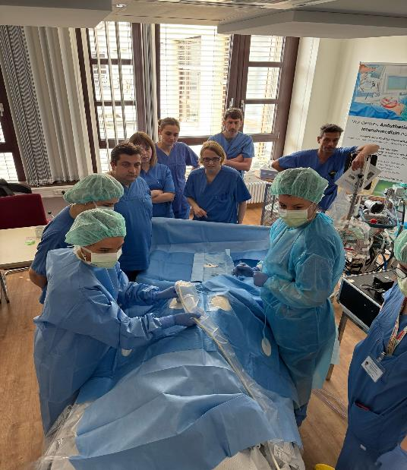
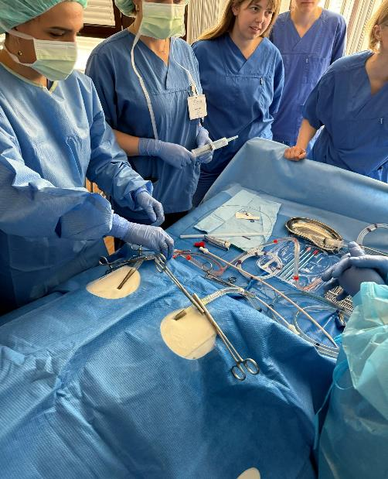
Achievements of WP2 (Clinical Management) in Montenegro
          Training with dummies
          Insertion of catheters
            Central lines / She
            Arterial lines
            Pacemaker
            ECMO cannulas
          Bronchoscopy

Slide 7
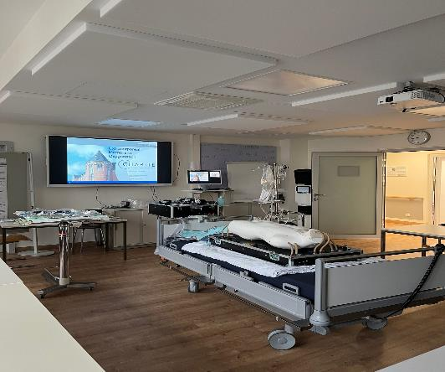
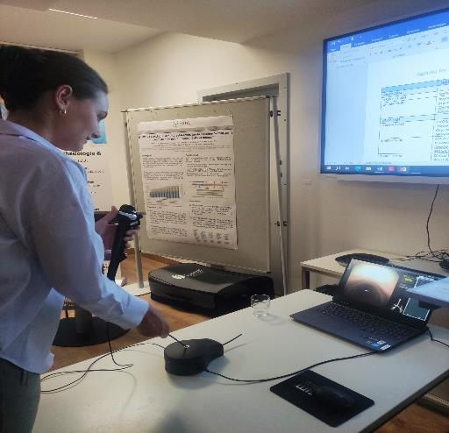
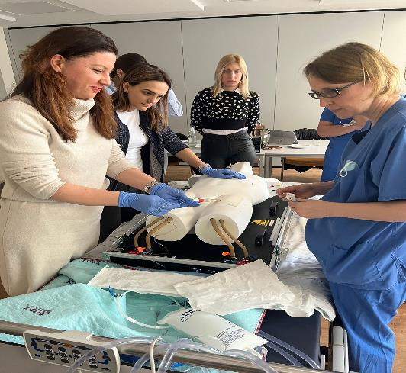
Achievements of WP2 (Clinical Management) in Montenegro
          Training with dummies
          Insertion of catheters
            Central lines / She
            Arterial lines
            Pacemaker
            ECMO cannulas
          Bronchoscopy

Slide 8
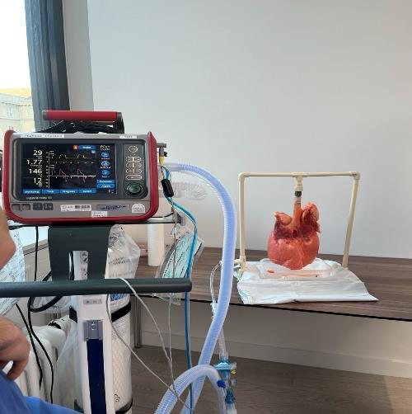
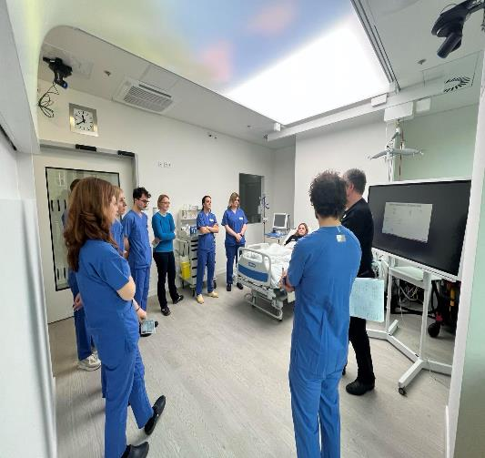
Achievements of WP2 (Clinical Management) in Montenegro
          Shadowing on the wards
          Transplant Unit
          Neuro- und Neurosurgical Unit
          Trauma- und ARDS Unit
          Mixed Units
          Hands on training
          Managemant of EVD
          Hemodynamic management
          Ultrasound

Slide 9
Achievements of WP2 (Clinical Management) in Montenegro
          Shadowing on the wards
          Transplant Unit
          Neuro- und Neurosurgical Unit
          Trauma- und ARDS Unit
          Mixed Units
          Hands on training
          Managemant of EVD
          Hemodynamic management
          Ultrasound

Slide 10
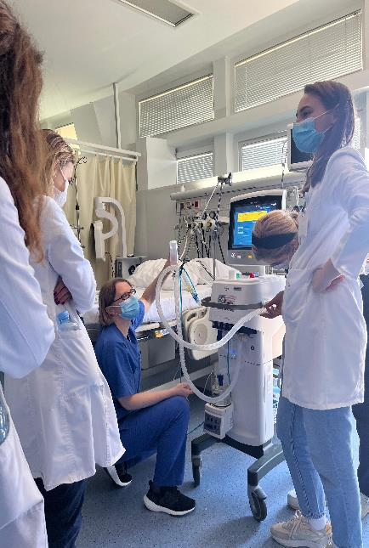
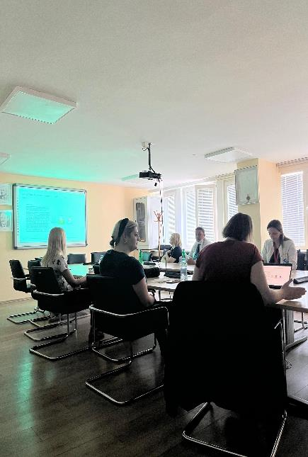
Implementation and Sustainability of WP2 (Clinical Management) in Montenegro
          ToT concept – multipliers of knowledge
          Trainings at KCCG
          In-person lectures open for all doctors
          Bedside discussions
          Implementation ideas

Slide 11
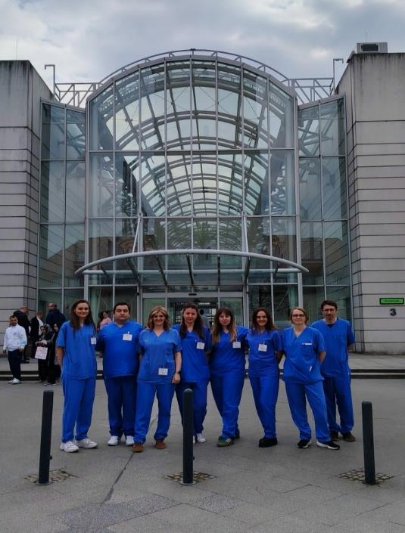
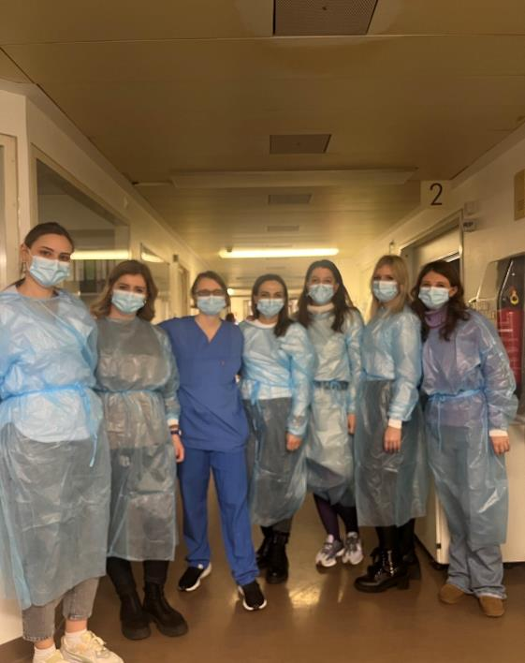
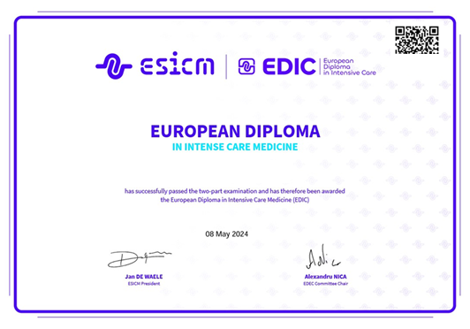
Implementation and Sustainability of WP2 (Clinical Management) in Montenegro
          Certification of Doctors

